Slide 1



Problem Statement
Your Customer
Empower small scale Aquaculture farmers socially and economically.
ADD LOGO HERE
In Kenya, Small Scale Aquaculture farmers lack high Quality, Affordable and Consistently available Aquafeeds.
Due to this challenge Small Scale Aquaculture farmers opt to formulate their own feeds, which lead to low fish production.
Small scale Aquaculture farmers

Slide 2

Provide small scale aquaculture farmers access to Quality and Affordable feeds by bringing Fish feed manufacturers and dealers to them.
Empower small scale Aquaculture farmers socially and economically.
Solution
ADD LOGO HERE

Slide 3
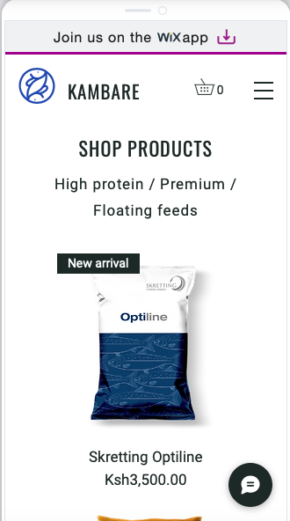
Our product is a mobile app, website and USSD that links Small Scale Aquaculture farmers to High Quality and Affordable Aqua feeds.
AquafeedKE App
Empower small scale Aquaculture farmers socially and economically.
Product
ADD LOGO HERE

Slide 4
Empower small scale Aquaculture farmers socially and economically.
TAM SAM SOM
ADD LOGO HERE
Africa
Total Available Market
65%
East Africa
Serviceable Available Market
60%
Kenya
Serviceable Obtainable Market
70%

Slide 5
Revenue Model
1
2
Charging a Subscription fee
Marking-Up on the commodities

Slide 6
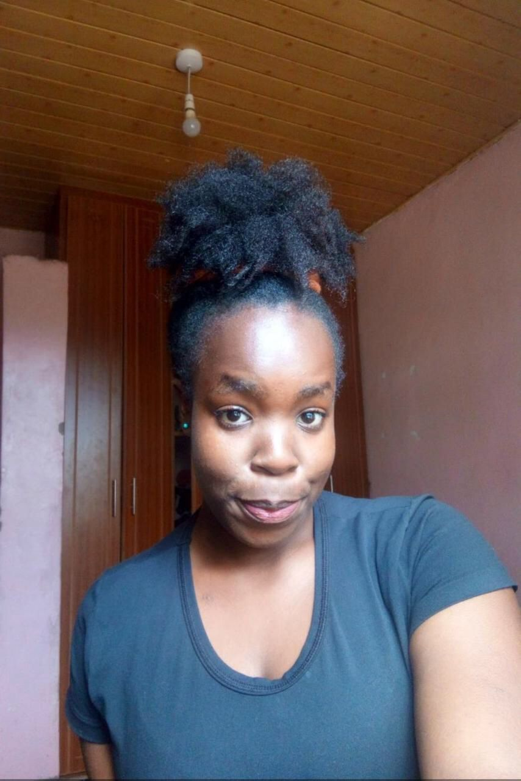


Team
Empower small scale Aquaculture farmers socially and economically.
ADD LOGO HERE
Joseph Nyingi
Data Scientist
Education: Moringa School Alumni
work experience . Afrimac Nut Ltd, UNESCO Fellow, Catalyst fund
Edge Tech & Catalyst
Winfry Nyarangi
Data Engineer
Education: Technical University of Kenya
work experience
KPLC
Edge Tech
Grayce Muthui
Education: Kenyatta University
Full stack Engineer
work experience
Diversity Cyber Council
Edge Tech

Slide 7





AquafeedKE and Sustainable Development Goals
Empower small scale Aquaculture farmers socially and economically
ADD LOGO HERE
When aquaculture farmers especially in arid and semi-arid areas access right feeds through platform they are empowered to increase stock harvest and family income.
AquafeedKE products enable aquaculture farmers arid and semi-arid areas increase their farm productivity to feed their families and sell excess to market.
When aquaculture farmers have access to feeds, they sustainably contribute to economic development while improving their livelihood.
AquafeedKE input linkage services enables farmers to become more resilient and adaptive to effects of climate change.

Slide 8
Empower small scale Aquaculture farmers socially and economically
ADD LOGO HERE
Q & A

